Slide 1
Deep learning with R
Huiyu Deng
Department of Preventive Medicine
Division of Biostatistics

Slide 2
Overview
Simple neural network (NN)
Activation function, loss function, forward and backward propagation
Keras/Tensorflow, R studio cloud
Example
Deep learning: Convolutional neural network (CNN)
Convolution, pooling, and flattening
Example

Slide 3
Simple Neural network
Parameters to transform the input (Beta coefficients in regression
Predictors, X variables, input variables etc.
Predicted outcome

Slide 4
Two-step framework of NN
Map input layer → Output layer: Forward propagation
Update the weights: Backward propagation

Slide 5
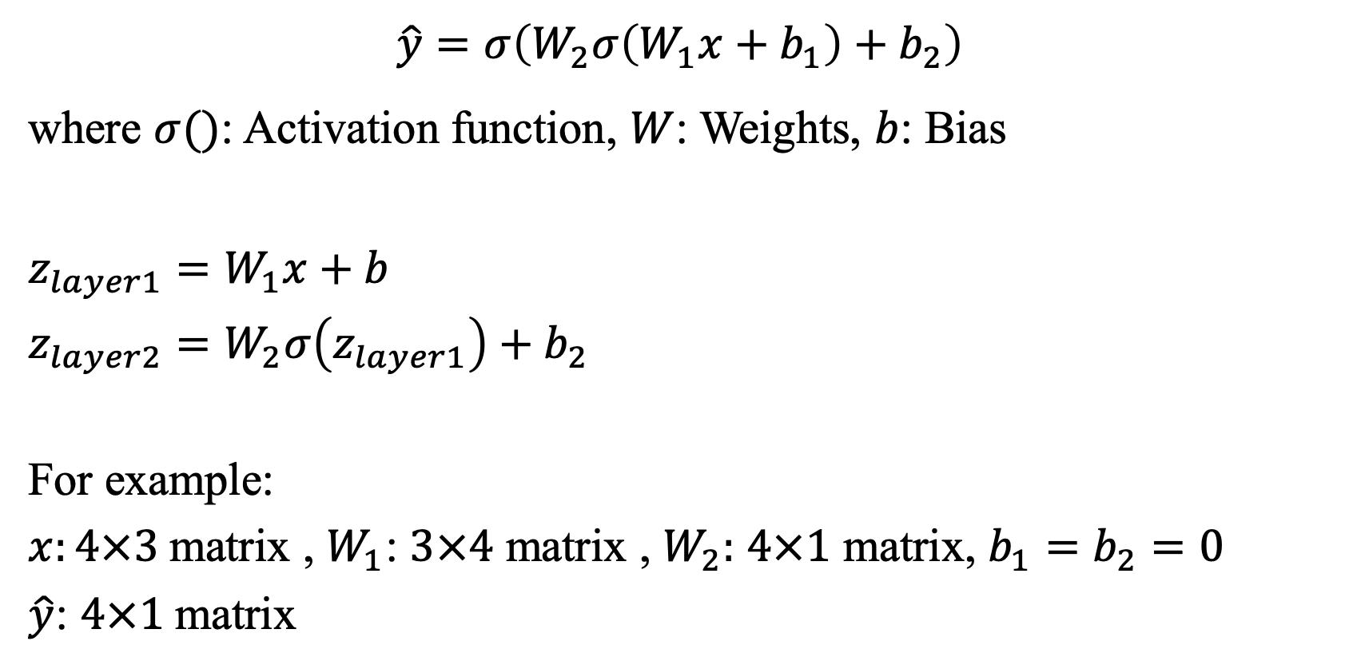
Forward propagation
$$\hat{y}=σ\left(W_{2}σ\left(W_{1}x+b_{1}\right)+b_{2}\right)$$
where $σ()$: Activation function, $W$: Weights, $b$: Bias
$z_{layer1}=W_{1}x+b$
$z_{layer2}=W_{2}σ\left(z_{layer1}\right)+b_{2}$
For example:
$x:4×3$matrix , $W_{1}$: $3×4$ matrix , $W_{2}:$ $4×1$ matrix, $b_{1}=b_{2}=0$
$\hat{y}$: $4×1$matrix
Notes:
Map input layer → Output layer
Take $x$ as the Input matrix and $y$ as the output
$\hat{y}=σ\left(z_{layer2}\right)=σ(W_{2}σ\left(W_{1}x+b_{1}\right)+b_{2})$

Slide 6
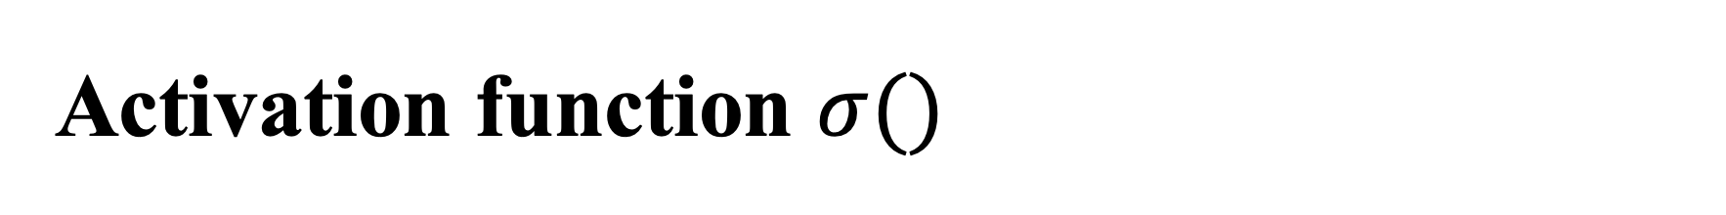
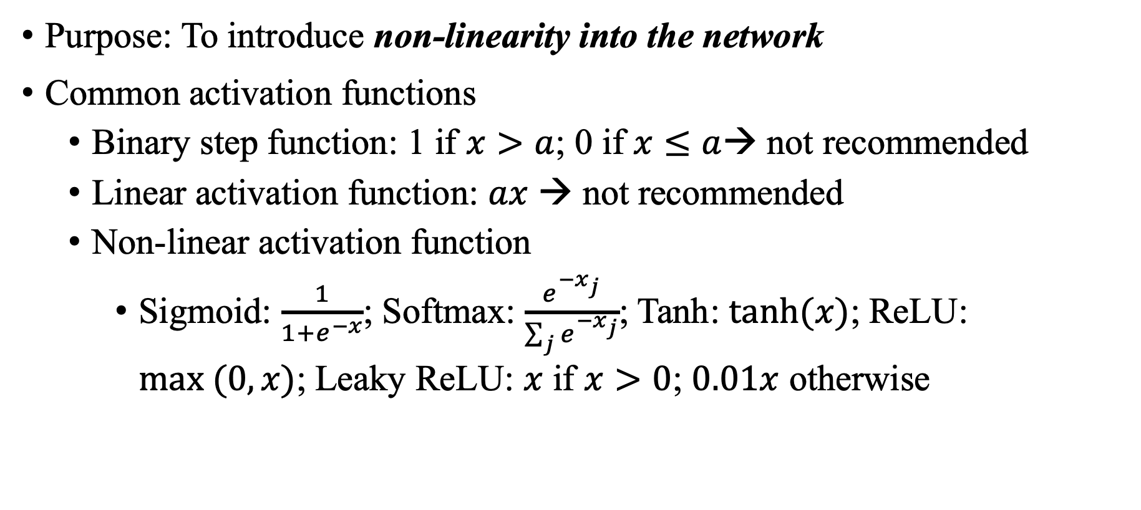
Activation function $σ()$
Purpose: To introduce non-linearity into the network
Common activation functions
Binary step function: 1 if $x>a$; 0 if $x≤a$→ not recommended
Linear activation function: $ax$ → not recommended
Non-linear activation function
Sigmoid: $\frac{1}{1+e^{−x}}$; Softmax: $\frac{e^{−x_{j}}}{\sum_{j}{e^{−x_{j}}}}$; Tanh: $tanh⁡(x)$; ReLU: $max (0,x)$; Leaky ReLU: $x$ if $x>0$; $0.01x$ otherwise
Notes:
in turn, this allows you to model a response variable (aka target variable, class label, or score) that varies non-linearly with its explanatory variables
https://stackoverflow.com/questions/9782071/why-must-a-nonlinear-activation-function-be-used-in-a-backpropagation-neural-net
https://missinglink.ai/guides/neural-network-concepts/7-types-neural-network-activation-functions-right/#commonnonlinear
https://towardsdatascience.com/activation-functions-neural-networks-1cbd9f8d91d6
Sigmoid Function Usage
The Sigmoid function used for binary classification in logistic regression model.
While creating artificial neurons sigmoid function used as the activation function.
In statistics, the sigmoid function graphs are common as a cumulative distribution function.
Softmax Function Usage
Used in multiple classification logistic regression model.
In building neural networks softmax functions used in different layer level.

Slide 7
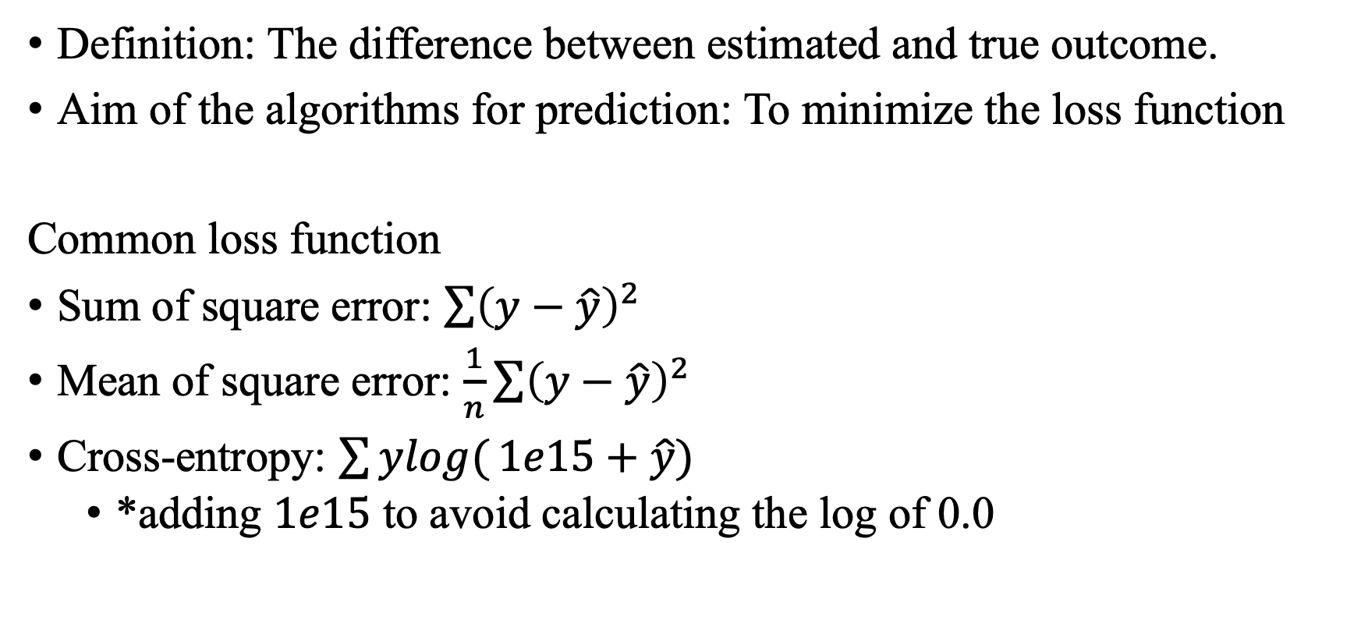
Loss function
Definition: The difference between estimated and true outcome.
Aim of the algorithms for prediction: To minimize the loss function
Common loss function
Sum of square error: $\sum{{\left(y−\hat{y}\right)}^{2}}$
Mean of square error: $\frac{1}{n}\sum{{\left(y−\hat{y}\right)}^{2}}$
Cross-entropy: $\sum{ylog(}1e15+\hat{y})$
*adding $1e15$ to avoid calculating the log of 0.0

Slide 8
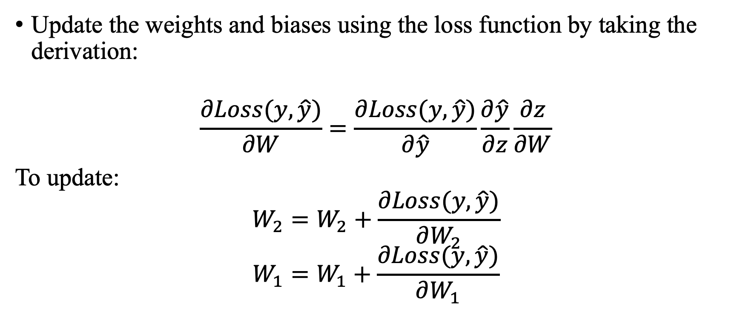
Backward propagation
Update the weights and biases using the loss function by taking the derivation:
$$\frac{∂Loss(y, \hat{y})}{∂W}=\frac{∂Loss(y, \hat{y})}{∂\hat{y}}\frac{∂\hat{y}}{∂z}\frac{∂z}{∂W}$$
To update:
$$W_{2}=W_{2}+\frac{∂Loss(y, \hat{y})}{∂W_{2}}$$
$$W_{1}=W_{1}+\frac{∂Loss(y, \hat{y})}{∂W_{1}}$$
Notes:
what is the W to minimize the loss function by taking the derivation:
In particular, $\frac{∂\hat{y}}{∂z}$ is the derivative of the activation function.

Slide 9
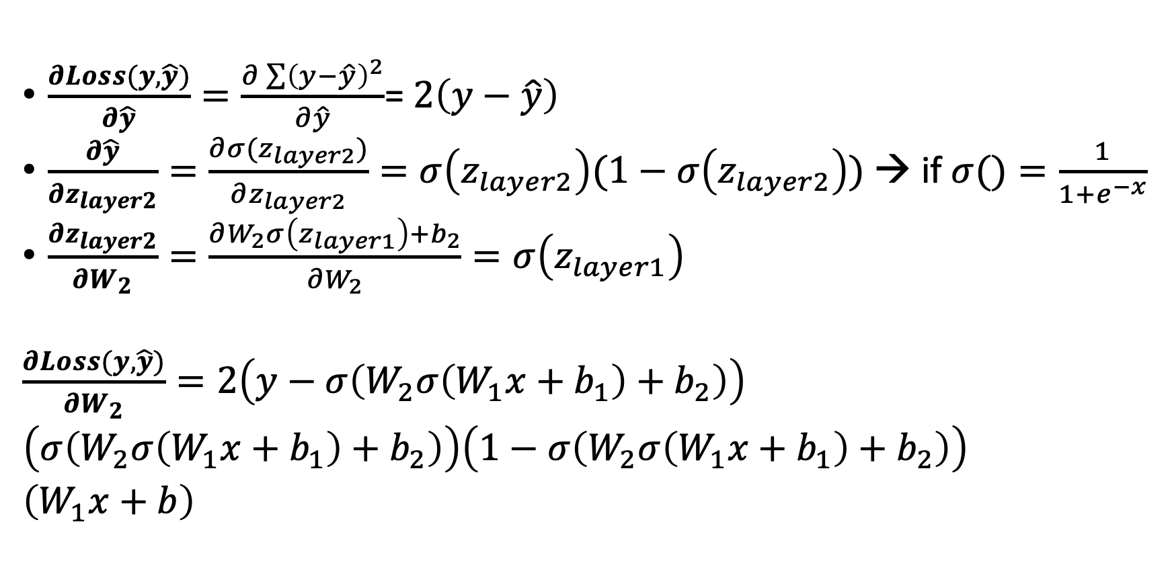

Backward propagation – $W_{2}$ (Extra slide)
$\frac{∂Loss(y, \hat{y})}{∂\hat{y}}=\frac{∂\sum{{\left(y−\hat{y}\right)}^{2}}}{∂\hat{y}}$= $2\left(y−\hat{y}\right)$
$\frac{∂\hat{y}}{∂z_{layer2}}=\frac{∂σ(z_{layer2})}{∂z_{layer2}}=σ\left(z_{layer2}\right)(1−σ\left(z_{layer2}\right))$ → if $σ()=\frac{1}{1+e^{−x}}$
$\frac{∂z_{layer2}}{∂W_{2}}=\frac{∂W_{2}σ\left(z_{layer1}\right)+b_{2}}{∂W_{2}}=σ\left(z_{layer1}\right)$
$\frac{∂Loss(y, \hat{y})}{∂W_{2}}=2\left(y−σ\left(W_{2}σ\left(W_{1}x+b_{1}\right)+b_{2}\right)\right)$
$\left(σ\left(W_{2}σ\left(W_{1}x+b_{1}\right)+b_{2}\right)\right)\left(1−σ\left(W_{2}σ\left(W_{1}x+b_{1}\right)+b_{2}\right)\right)$
$\left(W_{1}x+b\right)$

Slide 10

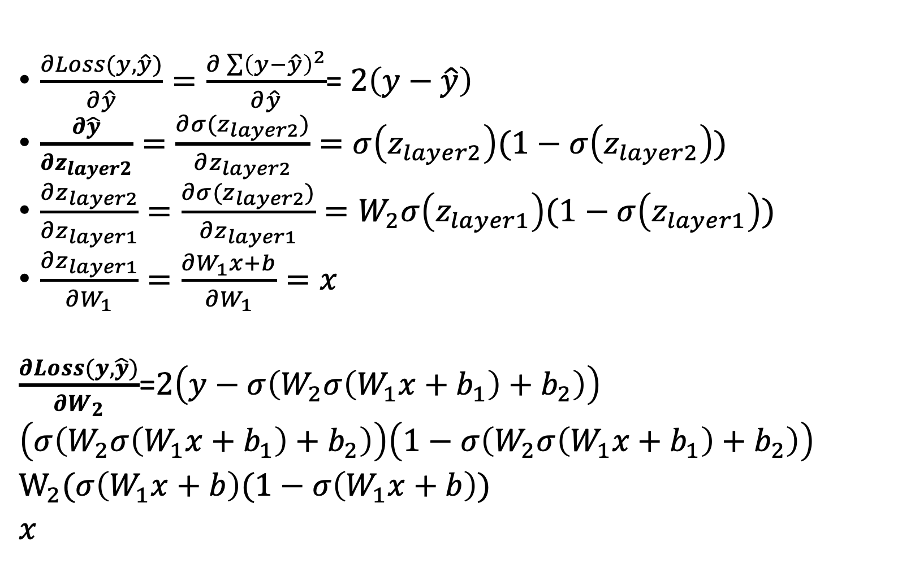
Backward propagation – $W_{1}$(Extra slide)
$\frac{∂Loss(y, \hat{y})}{∂\hat{y}}=\frac{∂\sum{{\left(y−\hat{y}\right)}^{2}}}{∂\hat{y}}$= $2\left(y−\hat{y}\right)$
$\frac{∂\hat{y}}{∂z_{layer2}}=\frac{∂σ(z_{layer2})}{∂z_{layer2}}=σ\left(z_{layer2}\right)(1−σ\left(z_{layer2}\right))$
$\frac{∂z_{layer2}}{∂z_{layer1}}=\frac{∂σ(z_{layer2})}{∂z_{layer1}}=W_{2}σ\left(z_{layer1}\right)(1−σ\left(z_{layer1}\right))$
$\frac{∂z_{layer1}}{∂W_{1}}=\frac{∂W_{1}x+b}{∂W_{1}}=x$
$\frac{∂Loss(y, \hat{y})}{∂W_{2}}$=$2\left(y−σ\left(W_{2}σ\left(W_{1}x+b_{1}\right)+b_{2}\right)\right)$
$\left(σ\left(W_{2}σ\left(W_{1}x+b_{1}\right)+b_{2}\right)\right)\left(1−σ\left(W_{2}σ\left(W_{1}x+b_{1}\right)+b_{2}\right)\right)$
$W_{2}(σ\left(W_{1}x+b\right)(1−σ\left(W_{1}x+b\right))$
$x$

Slide 11
To recap, neural network
Map input to outcome via layer (data transformation)
Update the weights and bias based on estimated and true outcome
Input X
Weights
Layer
Weights
Layer
Predicted Y
True Y
Loss function

Slide 12
Keras Library
Model-level library: Building blocks for deep-learning models
Backend engine of Keras: TensorFlow, Theano, Microsoft Cognitive ToolKit (CNTK)
TensorFlow: Most widely adopted, scalable, and production ready.
Open the html page:
Go over the installation step
Notes:
Keras is a model-level library, providing high-level building blocks for developing deep-learning models.
It doesn’t handle low-level operations such as tensor manipulation and differentiation.
Instead, it relies on a specialized, well-optimized tensor library to do so, serving as the backend engine of Keras.
Rather than choosing a single tensor library and trying the implementation of Keras to that library, Keras handles the problem in a modular way.
Thus, several different backend engines can be plugged seamlessly into Keras.
Currently, the three existing backend implementation are the Tensorflow, backend, the Theano backend, and the Microsoft Cognitive ToolKit (CNTK) backend.
Theano: by the MILA lab at U of Montreal
Tensorflow: google
CNTK:: Microsoft

Slide 13
Code exercise
Data: MNIST data (Reduced sample)
Sample size: 1000 train/test data each
Objective: Classify grayscale images of handwritten digits 28*28 pixels into their 10 categories
Open the R studio cloud (Copy and paste to your browser): bit.ly/2oFu6iy

Slide 14
Build the network
network<-keras_model_sequential() %>%
layer_dense(units=512, activation = "relu", input_shape=c(28*28)) %>%
layer_dense(units=10,activation="softmax")
Two dense layers:
First dense layer with 512 hidden units and Relu as the activation function
Second layer with 10-way softmax layers
Key decisions: How many 1) layers and 2) hidden units for each layer?
Notes:
#The network architecture (Two dense layers)
#The first dense layer (512) is the number of hidden units of the layer.
A hidden unit is a dimension in the representation space of the layer.
#output=relu(dot(W,input)+b)
#Having 512 hidden units means the weight matrix W will have shape (input dimension, 512), the dot product with W will project the input data onto a 512 dimensional representation space
#Having more hidden units (a higher-dimensional representation space) allows your network to learn more complex representations, but it makes the network more computationally expensive and may lead to learning unwanted patterns.
#The second (and last) layer is a 10-way softmax layers, which means it will return an array of 10 probability scores (summing to 1). Each score will be the probability that the current digit image belongs to one of the 10 digit classes.

Slide 15
Compile and fit the model
Compile step:
network %>% compile(
optimizer = "rmsprop",
loss = "categorical_crossentropy",
metrics = c("accuracy")
)
Fitting step:
network %>% fit(train_images, train_labels, epochs = 5, batch_size = 128)
Notes:
(loss function: categorical_crossentropy, optimizer: the exact rules governing a specific use of gradient descent are defined by the rmsprop optimizer passed as the first argument)
Optimizer: https://medium.com/octavian-ai/which-optimizer-and-learning-rate-should-i-use-for-deep-learning-5acb418f9b2
Sometimes you may want to configure the parameters of your optimizer or pass a custom loss function or metric function
https://keras.io/optimizers/
https://keras.io/losses/
https://keras.io/metrics/
#Fit the model (The network will start to iterate on the training data in mini-batches of 128 samples, 5 times over (each iteration over all the training data is called an epoch))

Slide 16
Deep learning
Emphasis on learning successive layers of increasingly meaningful representation
Convolution neural network: Image data
Recurrent neural network: Time-series data, text data
Generative deep learning (Variational autoencoders, generative adversarial networks)
Input X
Layer 1
Layer 2
Layer 3
……
Layer n
Predicted output

Slide 17
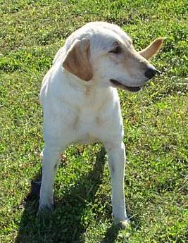
Examples of image classification
Dog vs. cat
Melanoma vs. healthy mole

Slide 18
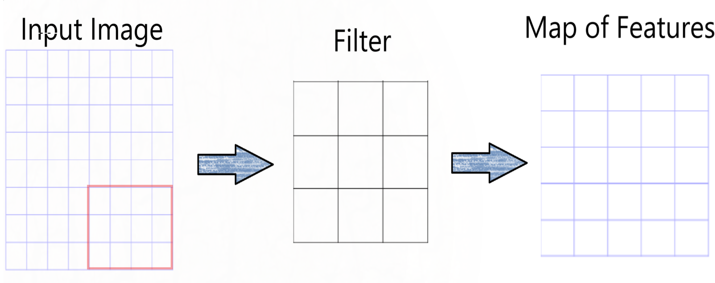
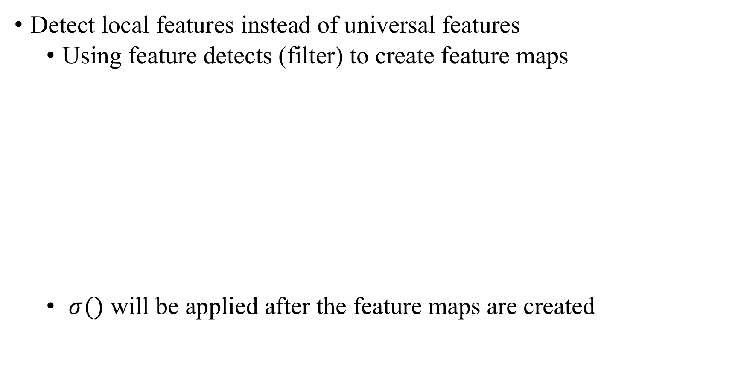
Convolutional neural network (CNN)
Detect local features instead of universal features
Using feature detects (filter) to create feature maps
$σ()$ will be applied after the feature maps are created
Notes:
Problem of using NN for image data: Large image size ($e.g. 367∗376$)
If we pass such a big input to a neural network, the number of parameters will swell up to a HUGE number (depending on the number of hidden layers and hidden units). This will result in more computational and memory requirements – not something most of us can deal with.
A function derived from two given functions by integration which expresses how the shape of one is modified by the other. There are 3 main elements of the convolution operation:
Input image: the actual image in pixels (basically our input data)
Feature detector: These can even be called filters. They basically detect certain features in the input image. Feature Detectors are placed over the input image (though are much smaller in size) and count the number of cells in which the feature detector matches a subset of the input image. The feature detector then moves alone the input image to cover all of its areas and the distances it moves can be referred to as “strides”.
Feature map: contains the arguments recorded by the filter over the input image. The value from the input image is initially inserted in the top-left cell of the feature map, and it moves a block to the right, recording the observation of every stride

Slide 19
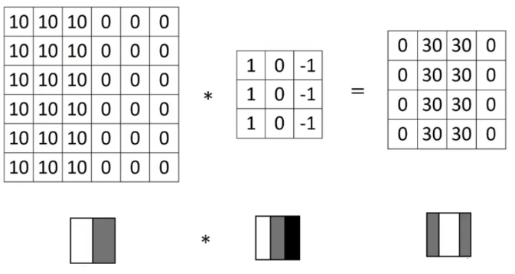
Example: Edge detection
Input map
Filter
Map of Features

Slide 20
Pooling
Purpose: To further modify the feature map to eliminate small movements
Two common functions: Max-pooling and average-pooling
Notes:
A limitation of the feature map output of convolutional layers is that they record the precise position of features in the input. This means that small movements in the position of the feature in the input image will result in a different feature map.
The addition of a pooling layer after the convolutional layer is a common pattern used for ordering layers within a convolutional neural network that may be repeated one or more times in a given model.
The pooling layer operates upon each feature map separately to create a new set of the same number of pooled feature maps.
Pooling involves selecting a pooling operation, much like a filter to be applied to feature maps. The size of the pooling operation or filter is smaller than the size of the feature map; specifically, it is almost always 2×2 pixels applied with a stride of 2 pixels.
This means that the pooling layer will always reduce the size of each feature map by a factor of 2, e.g. each dimension is halved, reducing the number of pixels or values in each feature map to one quarter the size. For example, a pooling layer applied to a feature map of 6×6 (36 pixels) will result in an output pooled feature map of 3×3 (9 pixels).
The pooling operation is specified, rather than learned. Two common functions used in the pooling operation are:
Maximum Pooling (or Max Pooling): Calculate the maximum value for each patch of the feature map.
Average Pooling: Calculate the average value for each patch on the feature map.
The result of using a pooling layer and creating down sampled or pooled feature maps is a summarized version of the features detected in the input. They are useful as small changes in the location of the feature in the input detected by the convolutional layer will result in a pooled feature map with the feature in the same location. This capability added by pooling is called the model’s invariance to local translation.
https://towardsdatascience.com/understanding-convolutions-using-excel-886ca0a964b7

Slide 21
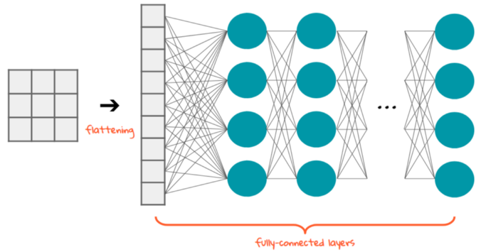
Flattening
Purpose: To convert the data into a 1-D array to fit the classification model through the fully-connected layers

Slide 22
To recap, convolutional neural network
Notes:
Spatial arrangement. We have explained the connectivity of each neuron in the Conv Layer to the input volume, but we haven’t yet discussed how many neurons there are in the output volume or how they are arranged. Three hyperparameters control the size of the output volume: the depth, stride and zero-padding. We discuss these next:
First, the depth of the output volume is a hyperparameter: it corresponds to the number of filters we would like to use, each learning to look for something different in the input. For example, if the first Convolutional Layer takes as input the raw image, then different neurons along the depth dimension may activate in presence of various oriented edges, or blobs of color. We will refer to a set of neurons that are all looking at the same region of the input as a depth column (some people also prefer the term fibre).
Second, we must specify the stride with which we slide the filter. When the stride is 1 then we move the filters one pixel at a time. When the stride is 2 (or uncommonly 3 or more, though this is rare in practice) then the filters jump 2 pixels at a time as we slide them around. This will produce smaller output volumes spatially.
As we will soon see, sometimes it will be convenient to pad the input volume with zeros around the border. The size of this zero-padding is a hyperparameter. The nice feature of zero padding is that it will allow us to control the spatial size of the output volumes (most commonly as we’ll see soon we will use it to exactly preserve the spatial size of the input volume so the input and output width and height are the same).

Slide 23
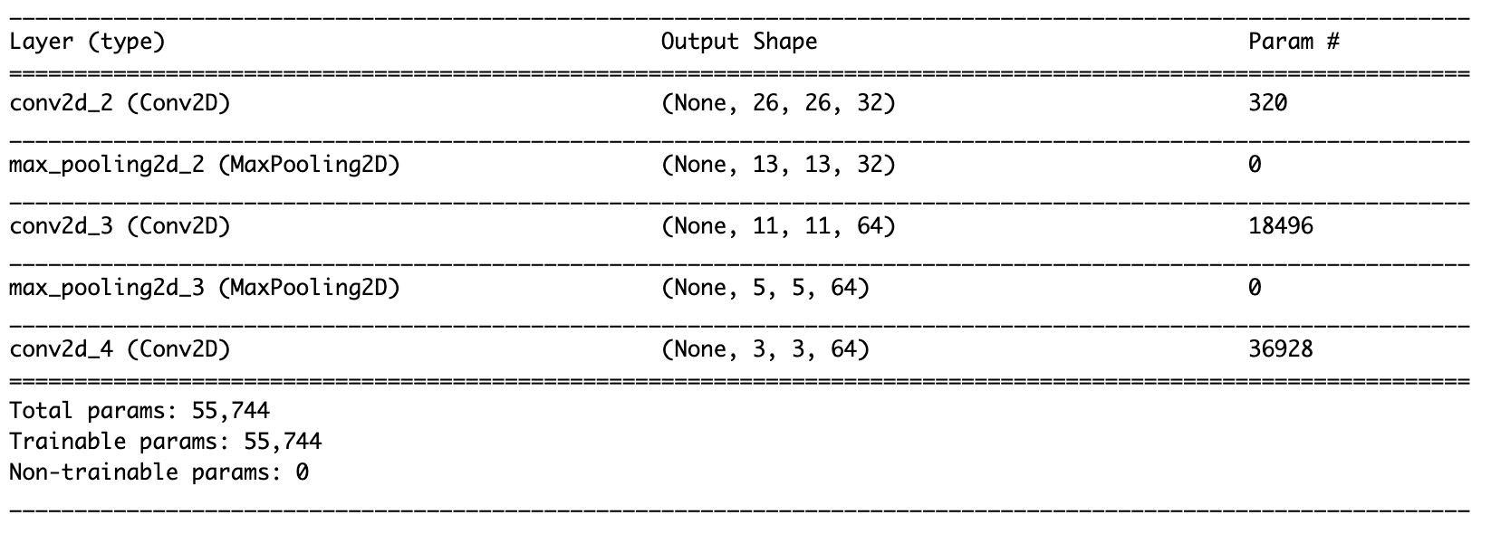
Build the network
model <- keras_model_sequential() %>%
layer_conv_2d(filters = 32, kernel_size = c(3,3), activation = "relu", input_shape=c(28,28,1)) %>%
layer_max_pooling_2d(pool_size=c(2,2)) %>%
layer_conv_2d(filters=64, kernel_size=c(3,3),activation="relu") %>%
layer_max_pooling_2d(pool_size=c(2,2)) %>%
layer_conv_2d(filters=64, kernel_size=c(3,3),activation="relu")
Notes:
IN this case, we will configure the convet to process inputs of size (28, 28, 1), which is the format of the MNIST images.

Slide 24
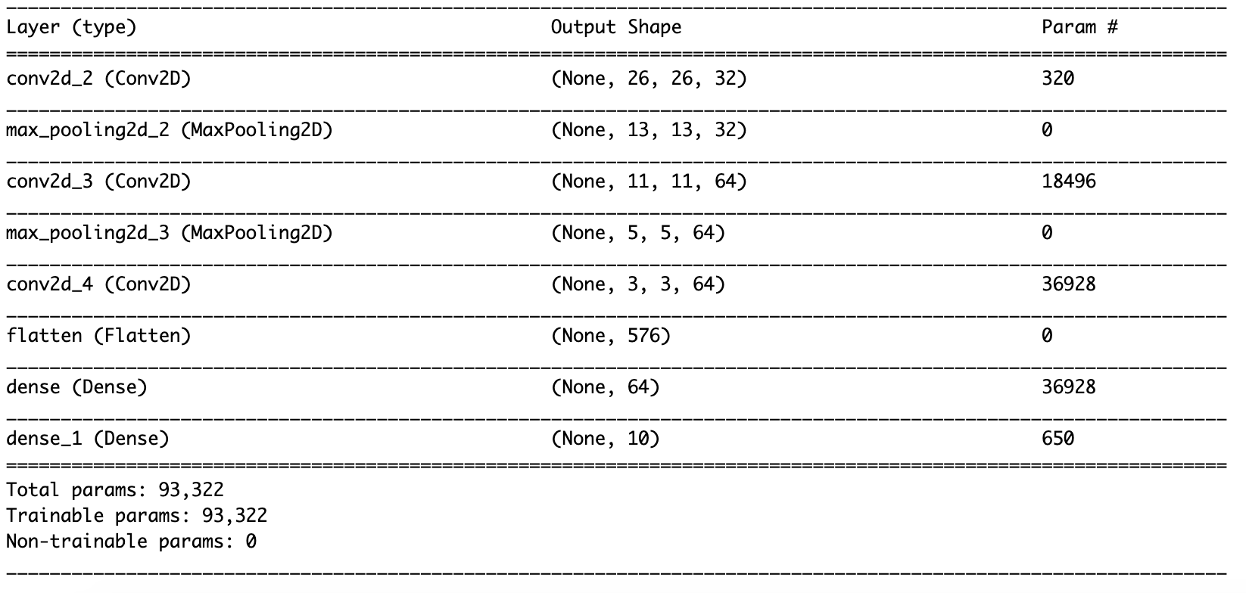
Densely connected classifier network
model <- model %>%
layer_flatten() %>%
layer_dense(units = 64, activation = "relu") %>%
layer_dense(units = 10, activation = "softmax")
Notes:
The next step is to feed the last output tensor (3,3,64) into a densely connected classifier network.

Slide 25
Questions?

